Slide 1

Implementation
Group
LoD 10 (Gender Mainstreaming)
3rd Erasmus+ Gender
Seminar at EMA
European Initiative
for the exchange of young officers inspired by Erasmus
The Initiative
Erasmus
Militaire
Military
Erasmus
EMILYO

Slide 2
Contents of the Briefing
How …. | …. it began?
Who …. | …. is involved?
What …. | …. are we doing? …. has been achieved?
Future …. | …. developments?

Slide 3
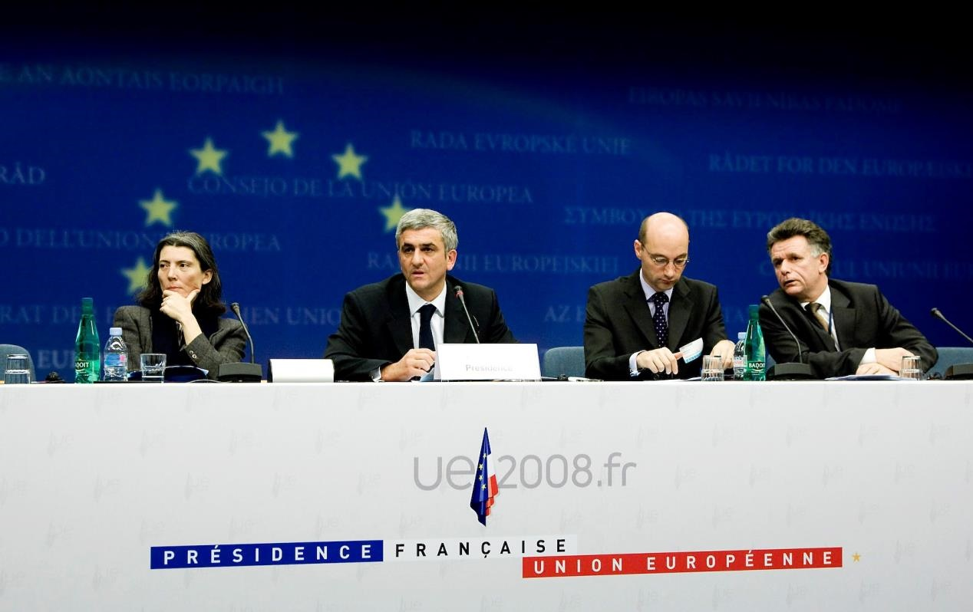
How it began (Nov. 2008)
➔ Declaration of EU MoDs
Establish an Implementation Group (IG) for the
„European initiative for the exchange of young officers inspired by Erasmus“
Goals: Increase interoperability & “harmonise” EU Basic Officer Education – thus, promote a
“European Security and Defence Culture”
Source: Council of the European Union, Council Conclusions on the ESDP, 2903rd External Relations Council Meeting. Brussels. 10th and 11th November, 2008.

Slide 4
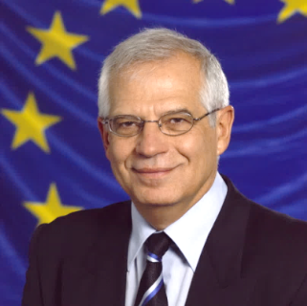
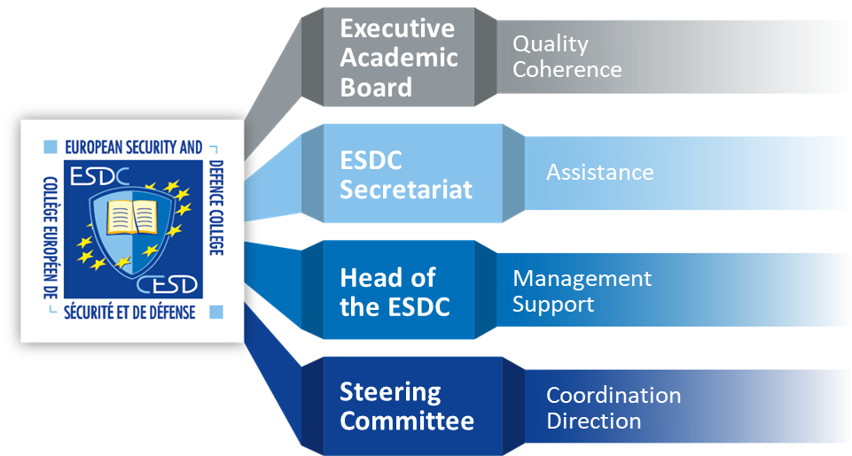
Who is involved in the Initiative
Josep
Borrell
HR/VP
European External Action Service (EEAS)
“EU Ministry of Foreign Affairs”
Implementation Group
Basic Officer Education Institutions’ Representatives
National Representatives
~ 27 EU Member States + 1 Assoc. Member
~ 62 EU Basic Officer Education Institutions
Army
Air Force
Navy
Technical
Medical
Military Force charged with Police Duties (e.g.: Carabinieri)
Militarised Police Force (e.g.: Guardia di Finanza)

Slide 5
What are we doing (Lines of Development)
Implementation Group
Basic Officer Education Institutions’ Representatives
LoD 1 System of Equivalences |  | LoD 2 Development of Competences |  | LoD 3 Development of IDL/e-learning |  | LoD 4 Create an IT-Platform |  | LoD 5 (Legal) Framework
LoD 6 National Implemen-tation of the Programme |  | LoD 7 Financing the Initiative |  | LoD 8 Common Modules |  | LoD 9 Future Projects |  | LoD 10 Gender Mainstreaming
LoD 11 International Naval Semester |  | LoD 12 International Air Force Semester |  | LoD 13 International Technical Semester |  | LoD 14 Research & Development |  | LoD 15 International Medical Semester

Slide 6
What are we doing (Lines of Development)
Implementation Group
Basic Officer Education Institutions’ Representatives
LoD 1 System of Equivalences |  | LoD 2 Development of Competences |  | LoD 3 Development of IDL/e-learning |  | LoD 4 Create an IT-Platform |  | LoD 5 (Legal) Framework
LoD 6 National Implemen-tation of the Programme |  | LoD 7 Financing the Initiative |  | LoD 8 Common Modules |  | LoD 9 Future Projects |  | LoD 10 Gender Mainstreaming
LoD 11 International Naval Semester |  | LoD 12 International Air Force Semester |  | LoD 13 International Technical Semester |  | LoD 14 Research & Development |  | LoD 15 International Medical Semester

Slide 7
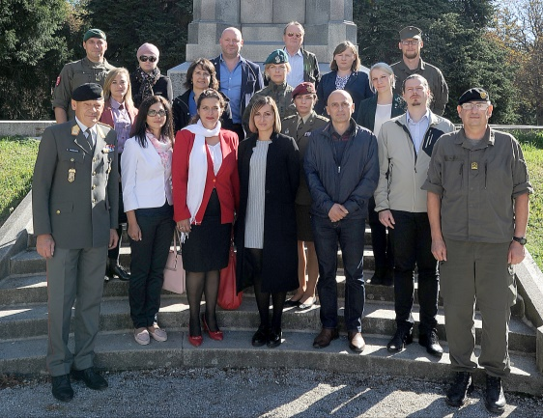
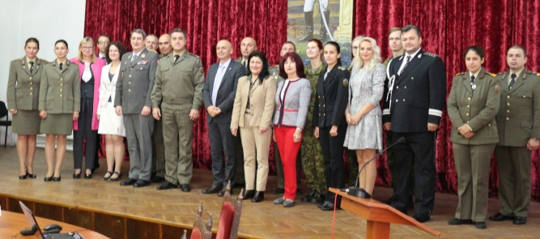
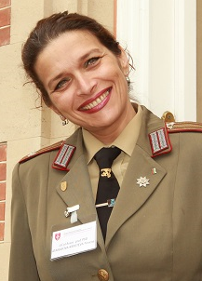
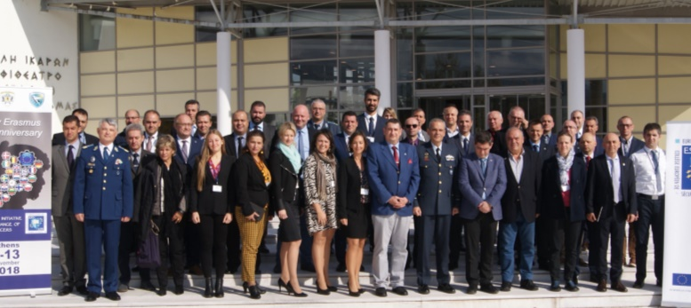
What are we doing (Line of Development 10 Milestones)
Implementation Group
Basic Officer Education Institutions’ Representatives
December 2020: SPP
Military Gender Studies
(PT, BG, IT, RO, GR)
September 2018 in AT:
1st Erasmus+
Gender Seminar
LoD 10 Gender Mainstreaming
October 2019 in BG:
2nd Erasmus+ Gender Seminar
IG voted
on the
Chairperson
in November 2018
Col Assoc. Prof.
ATANASOVA-KRASTEVA
Nevena, PhD
Officially
launched
in
November
2018

Slide 8
What are we doing (Line of Development 10 Past / Future)
Implementation Group
Basic Officer Education Institutions’ Representatives
At least
6 meetings
per year
LoD 10 Gender Mainstreaming
Sequence / when? | What | (Expected) Outcomes
Sep 2018 | 1st Gender Seminar | White Paper
Nov 2018 | Officially launched
Oct 2019 | 2nd Gender Seminar | Organise a Train the Trainers course
Quarterly IG Meetings | LoD 10 Meeting | Elaborations (Common Module expected)
Annual Gender Seminar | Specific Topics | Elaborations
Annual iMAF | Specific Topics | Elaborations
SPP (30 months) | Military Gender Studies | Questionnaire ➔ (http://www.emilyo.eu/node/1445) MGS army handbook

Slide 9
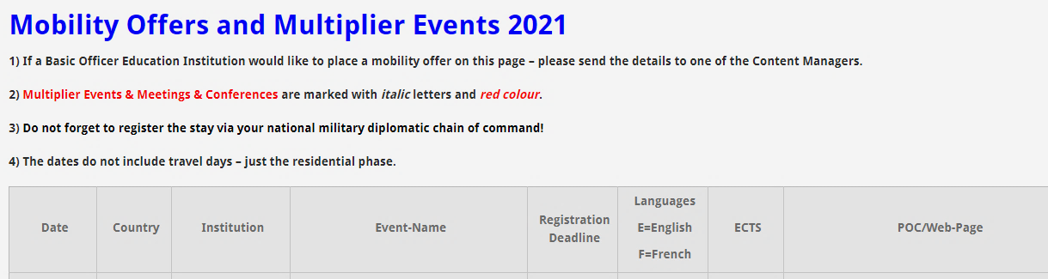
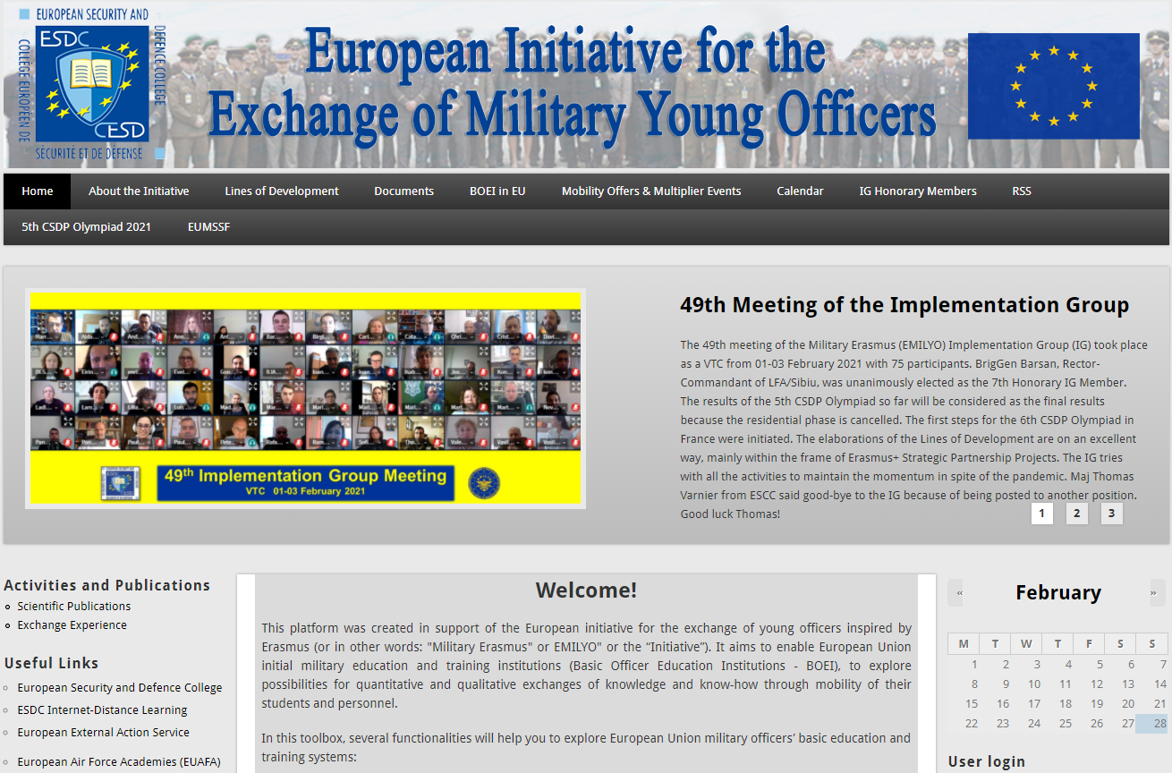
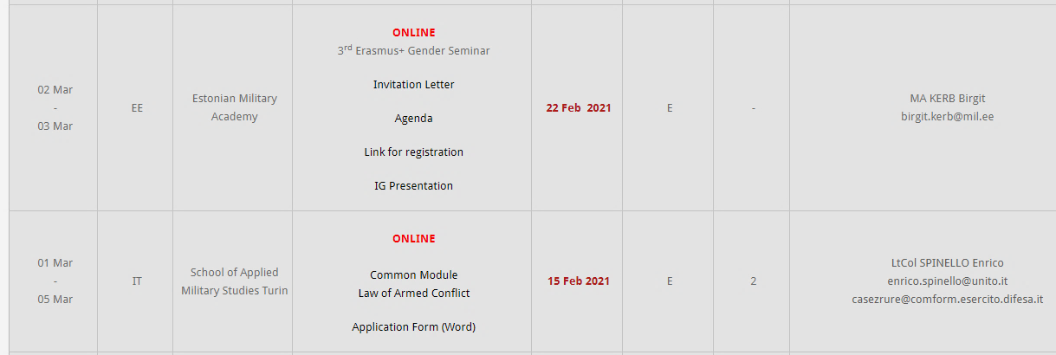
Further Information www.emilyo.eu

Slide 10
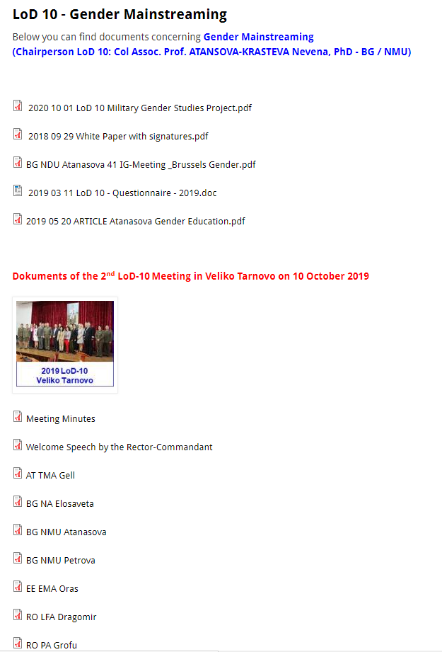
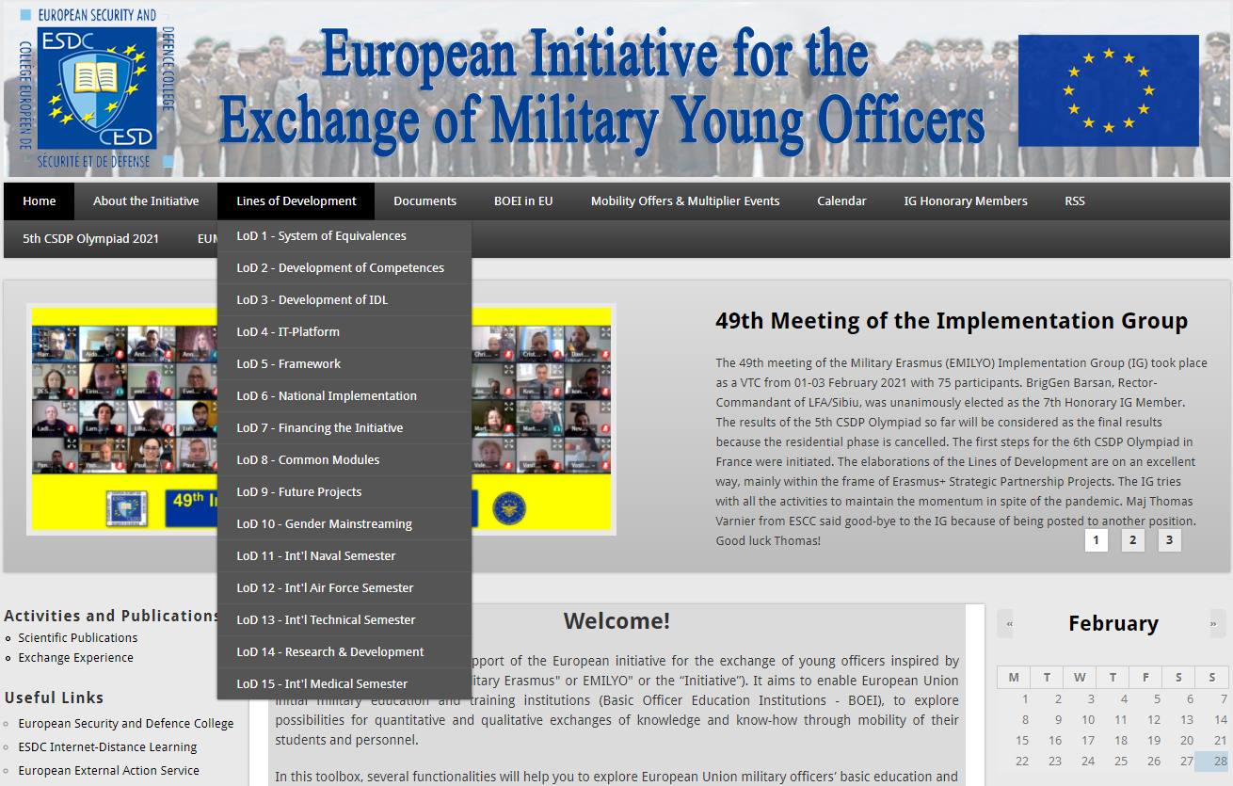
Further Information – LoD 10 www.emilyo.eu

Slide 11
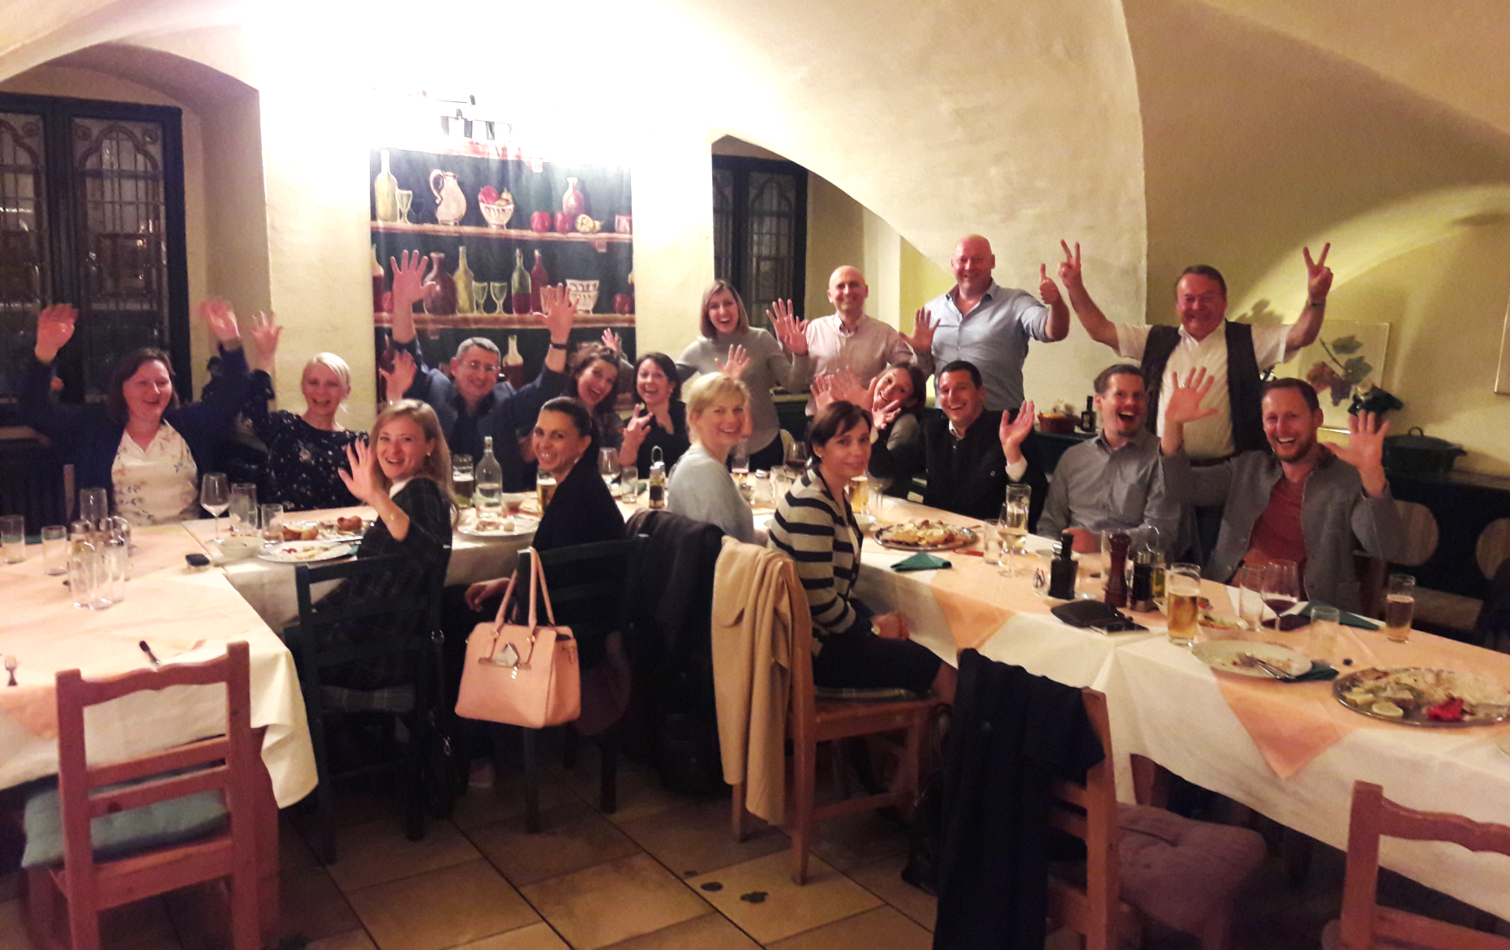
1st Erasmus+ Gender Seminar
Friends achieve more!

Slide 12



thank YOU
for YOUR
attention!

